Slide 1
TB CASE REVIEW
Presented by
Dr. Lynn Hernandez
&
Ramona Anderson RN, BS HSM
MECKLENBURG COUNTY HEALTH DEPARTMENT

Slide 2
Background Information
52 y/o Mexican male presented to ED with c/o generalized weakness x 2 wks
ROS: + mild cough x 1 mo, dry mouth, thirst, wt loss
Denied N/V/HA/CP/SOB/Fever
Soc. Hx: nonsmoker, h/o heavy ETOH – quit several years ago, landscaper, single, no children
PMH: high cholesterol, taking “natural thyroid medicine”
prescribed by a naturopath for his fatigue

Slide 3
Examination & Labs
EKG: Normal
VS: T 99.5 BP 136/77 HR 121 SpO2 100%
Physical Exam: Normal
Labs: WBC 7.7, Hb 8.3, Plt 408, MCV 77, Na 117, K 3.4, BUN 12, Creatinine 0.77, Glucose 174, AST 75, ALT 90, TSH wnl
Admitted for hyponatremia workup & correction

Slide 4

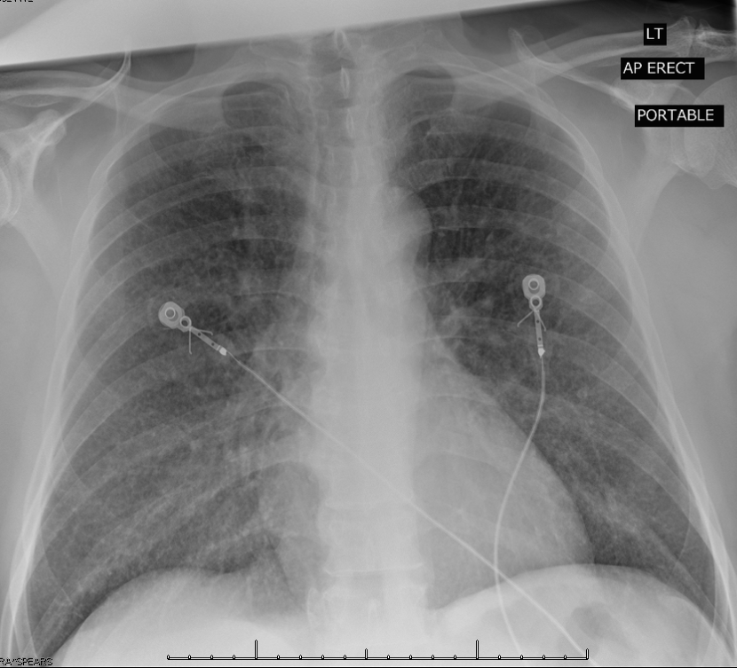
CXR
Ordered due to + cough on ROS
Findings: Pulmonary nodules in a miliary pattern

Slide 5
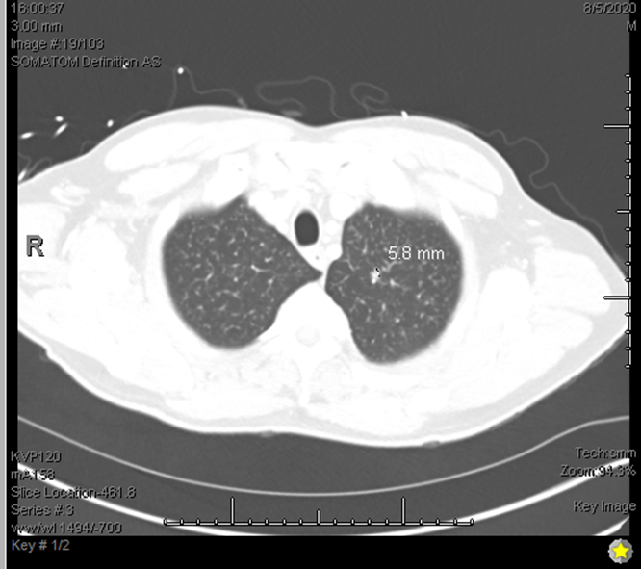
CT Chest
Numerous bilateral miliary nodules

Slide 6
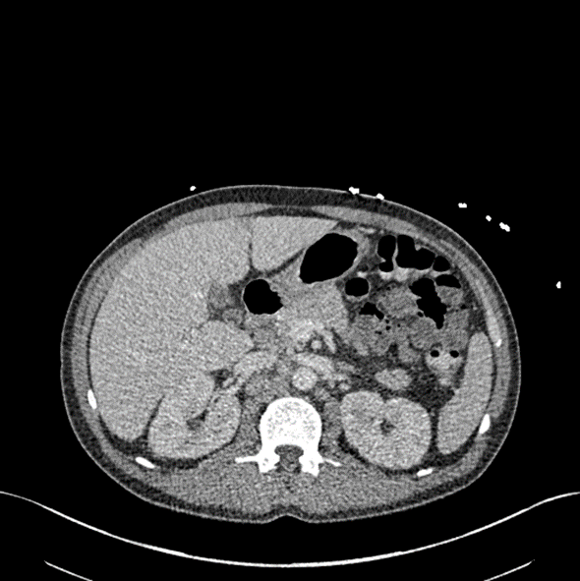
CT Abdomen/Pelvis
Circumferential mass within the proximal ascending colon with involvement of the ileocecal valve & terminal ileum
Abdominal lymphadenopathy

Slide 7
TB Workup
PPD 0mm; QFT = Negative
HIV Test = Reactive
Viral load = 558,000
CD4 = 22
CD8 = 205
CD4/CD8 ratio = 0.1

Slide 8
Bronchoscopy
Bronchoscopy with BAL & Biopsy
Smear = No AFB on BAL or Biopsy
Pathology Report on Biopsy
Benign bronchial mucosa and alveolated lung parenchyma with peribronchial chronic inflammation, possible epithelioid cell/histiocytic granuloma/aggregates and patchy interstitial chronic inflammation with some focal organization

Slide 9
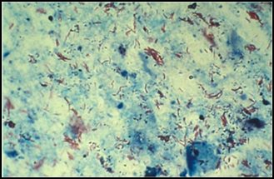
Cervical Lymph Node Excision
  AFB Smear = 4+
  Gram stain: 1+ Gram Pos. cocci
  GMS stain negative for fungus
  Pathology Report
  Necrotizing granulomatous inflammation

Slide 10
Example of Ileocecal TB as seen on Colonoscopy
  An ulcerated non-obstructing large mass was found in the ascending colon & in the cecum.
  The mass was partially circumferential (involving one half of the lumen circumference).
Text & Image from Prabhu et al. 2019

Slide 11
Colonoscopy Pathology Report
1) Biopsy of Cecal mass: Mycobacterial inflammatory pseudotumor
2) Biopsy of Colon: Mycobacterial colitis

Slide 12
MRI Brain
Mild cortical volume loss and chronic ischemic microvascular changes
No changes concerning for TB
Notes:
Include MRI Brain as a sidebar?

Slide 13
Treatment
RBT, INH, PZA, EMB initiated in the hospital for presumptive disseminated TB
Triumeq started 7 days later
Prednisone 40mg daily x 2 weeks, to be followed by 20mg/d x 2 wks to help prevent immune reconstitution inflammatory syndrome
Admission lasted 27 days
Notes:
Reason for RBT Vs RIF: Client to start antiretroviral medication

Slide 14
MCHD TB Clinic
Lymph node culture: +M. Tb
Sputum: Collected every 2 weeks, all smear neg, + M. Tb on culture
BAL/RML bx: Smear neg, +M. Tb on culture
All specimens were pansensitive
MDDR: No mutations
Due to co-infection w/HIV & low CD4 count, drug levels for RBT & INH were done and levels were wnl.

Slide 15
Subsequent ED Visit & Admission
18 days later - returned to ED with HA, difficulty speaking, and involuntary muscle twitching involving the head and RUE
Ammonia level wnl
HIV Viral load: 195
CT angiography of neck and brain showed no acute hemorrhage, infarction, or stenosis

Slide 16
Lumbar Puncture
CSF clear
Glucose = 50
Protein = 33
WBC’s = 2; RBC’s = 2; Nucleated cells = 2
Cryptococcal Antigen negative
Culture negative for TB

Slide 17
Continuous EEG
Frequent episodes of periodic mycoclonus with an EEG correlate that is difficult to interpret d/t the preponderance of myoclonic artifact in the waveforms associated with the movement and lack of interictal discharges.
It is not entirely certain that the movements are cortical/epileptic in origin as opposed to subcortical/spinal.
Notes:
While hospitalized client underwent continuous EEG monitoring

Slide 18
MRI Brain # 2
No acute intracranial abnormality
Interval development of areas of FLAIR signal abnormality and punctate foci of enhancement involving the cerebral parenchyma without significant mass effect
Mild chronic microvascular changes and volume loss
Notes:
Client responded well to treatment and symptoms were resolved.

Slide 19
Hospital Course
Due to concern for INH induced myoclonus, INH held x 2 days with no improvement in sx, so INH restarted
Next, Klonopin & Keppra were started and no changes in EEG waveforms were noted.

Slide 20
Hospital Course
Differential diagnosis included Immune Reconstitution Inflammatory Syndrome; sx seem to have started when the prednisone taper ended
Started on Prednisone 60mg QD x 2 wks
Discharged after 11 days on Prednisone, Baclofen and Chlorpromazine and f/u scheduled with Neurology

Slide 21
ED Visit & Admission
Returned 3 days later to the ED with c/o difficulty breathing related to intractable hiccups and blinking of eyes, continued involuntary movements of head and UE
Admitted due to tachycardia, worsening LFT’s and progression of neuro sx

Slide 22
Lumbar Puncture # 2
CSF: Clear
Glucose = 66
Protein = 39
WBC’s = 2
RBC’s = 0
Nucleated cells = 2
PCR & Culture = Negative for M. Tb

Slide 23
MRI Brain # 3
Compared to previous 2 MRI studies, interval increased and new areas of FLAIR hyperintense signal with associated increased diffusion signal in the bilateral cerebral hemispheres which may be due to acute embolic ischemia.

Slide 24
Hospital Course
Diagnosis: Opsoclonus Myoclonus Ataxia Syndrome
Treatment: Valium 5mg IV Q6h; Solu Medrol 1Gm QD x 5 days; Valproic Acid 1500mg IV BID, Vit B6 100mg IV QD & 100mg oral QD.
Discharge medications: Depakote & Prednisone

Slide 25
Treatment Course
Client experienced diminishing symptoms that eventually resolved over the next 3 months
PZA & EMB discontinued after 8 weeks of therapy
Continued on INH and RBT
Notes:
D/C’d 9/29/20 and returned to ED 10/2/20 c/o difficulty breathing r/t intractable hiccups and blinking. Admitted for tachycardia, (worsening) increasing LFT’s, and progression of neurological sx

Slide 26
ED Visit & Admission
Progressing well for 3 months, then he presented to the ED with c/o lower abdominal pain, vomiting and decreased appetite.
Admitted for SBO
Conservative treatment with NG tube & medication was not effective

Slide 27
CT Scan Abdomen/Pelvis # 2
Small bowel obstruction at the level of the ileocecal valve at the site of previously known & biopsied mycobacterial inflammatory pseudotumor
Slightly improved miliary pattern at the lung bases

Slide 28
Surgeries
Exploratory laparotomy & Ileocecectomy
Wound left open pending pathology
Pathology Report
Ileum & Cecum, Resection: Mycobacterial colitis
Appendix with Fibrous Obliteration of the Lumen

Slide 29
Surgeries
Second surgery the next day for the creation of an end ileostomy, with ileostomy bag placement
Drug levels for INH & RBT were repeated d/t bowel resection, levels were normal
Reversal of the ileostomy 6 months later

Slide 30
Outcome
Treated for 52 weeks due to concerns for possible CNS involvement
Back to work full-time
No longer has ileostomy bag
Neuro symptoms have not recurred
Continues to follow-up with ID and is compliant with HIV treatment

Slide 31

Thank You!
®

